Slide 1
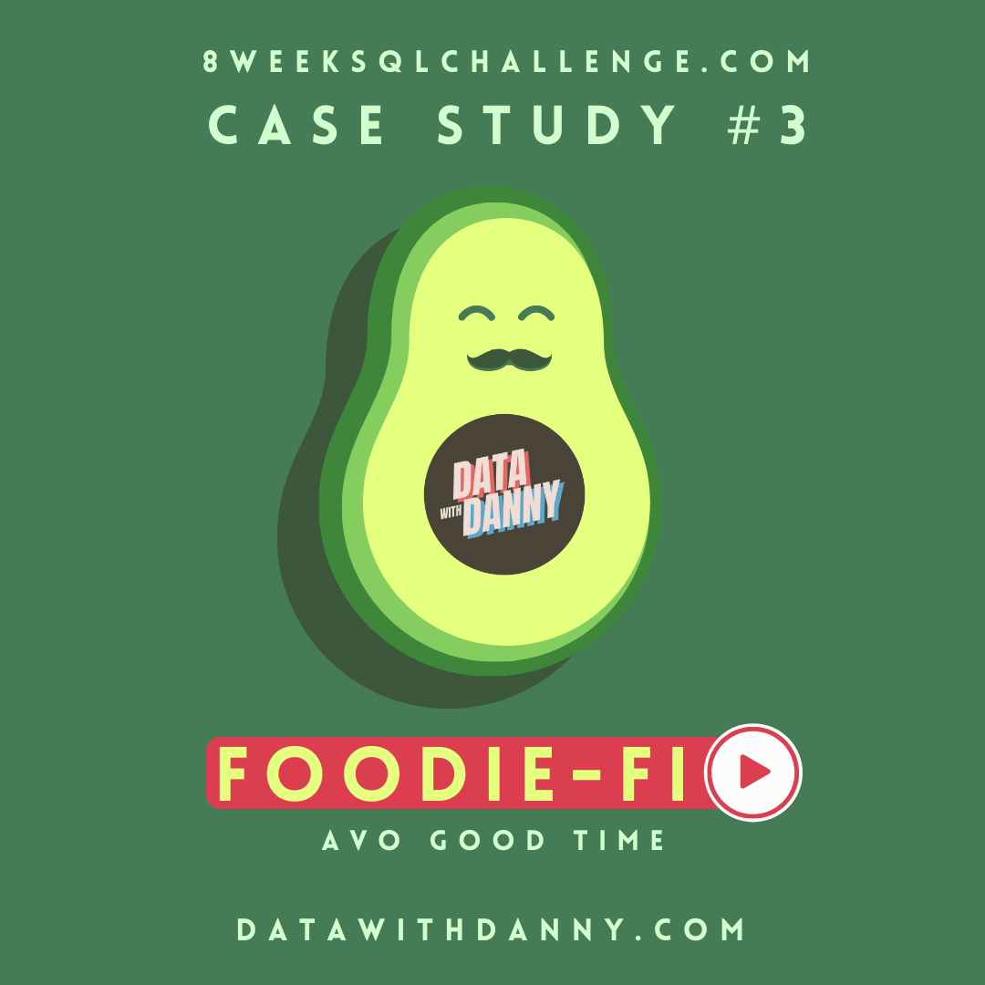
SQL
Business Case Study
- Kriti Tiwari

Slide 2
INTRODUCTION:
In 2020, Danny identified a gap in the market and launched Foodie-Fi, a unique streaming service focused exclusively on food-related content. Like Netflix but for cooking shows, Foodie-Fi offers unlimited on-demand access to exclusive culinary videos through monthly and annual subscriptions.
With a data-driven approach at its core, Foodie-Fi uses subscription data to inform key business decisions and shape future developments.
This case study emphasizes the use of data to address crucial business inquiries.

Slide 3
TABLE 1: PLANS
Subscription Plans: Foodie-Fi offers two main subscription options. The Basic Plan costs $9.90 monthly and provides limited access to streaming content. The Pro Plan is available for $19.90 monthly or $199 annually, offering unlimited streaming and the ability to download videos for offline viewing.
Free Trial: New customers can start with a 7-day free trial, which automatically transitions to the Pro monthly plan unless the customer cancels. During the trial, customers have the flexibility to cancel their subscription, downgrade to the Basic plan, or upgrade to the Pro annual plan.
Cancellation Process: If a customer decides to cancel, their plan continues until the end of the current billing period. Afterward, a churn plan record is created with a null price, effectively ending their subscription.

Slide 4
TABLE 2: SUBSCRIPTIONS
Subscription Start Date: The subscriptions table shows the exact start date when each plan_id begins.
Downgrades & Cancellations: When customers downgrade or cancel, the higher plan stays active until the period ends. The start_date updates only when the new plan or cancellation takes effect.
Upgrades: Upgrades from Basic to Pro or Annual Pro plans take effect immediately, with the start_date reflecting this change.
Churn: Upon churn, customers retain access until the billing period ends, but the start_date is recorded as the day they canceled.

Slide 5
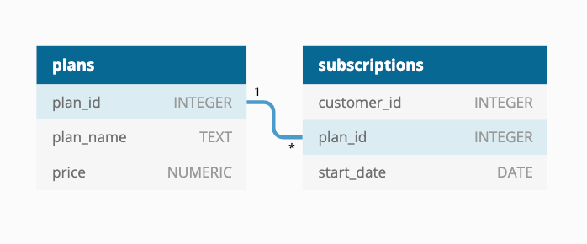
ER DIAGRAM:

Slide 6
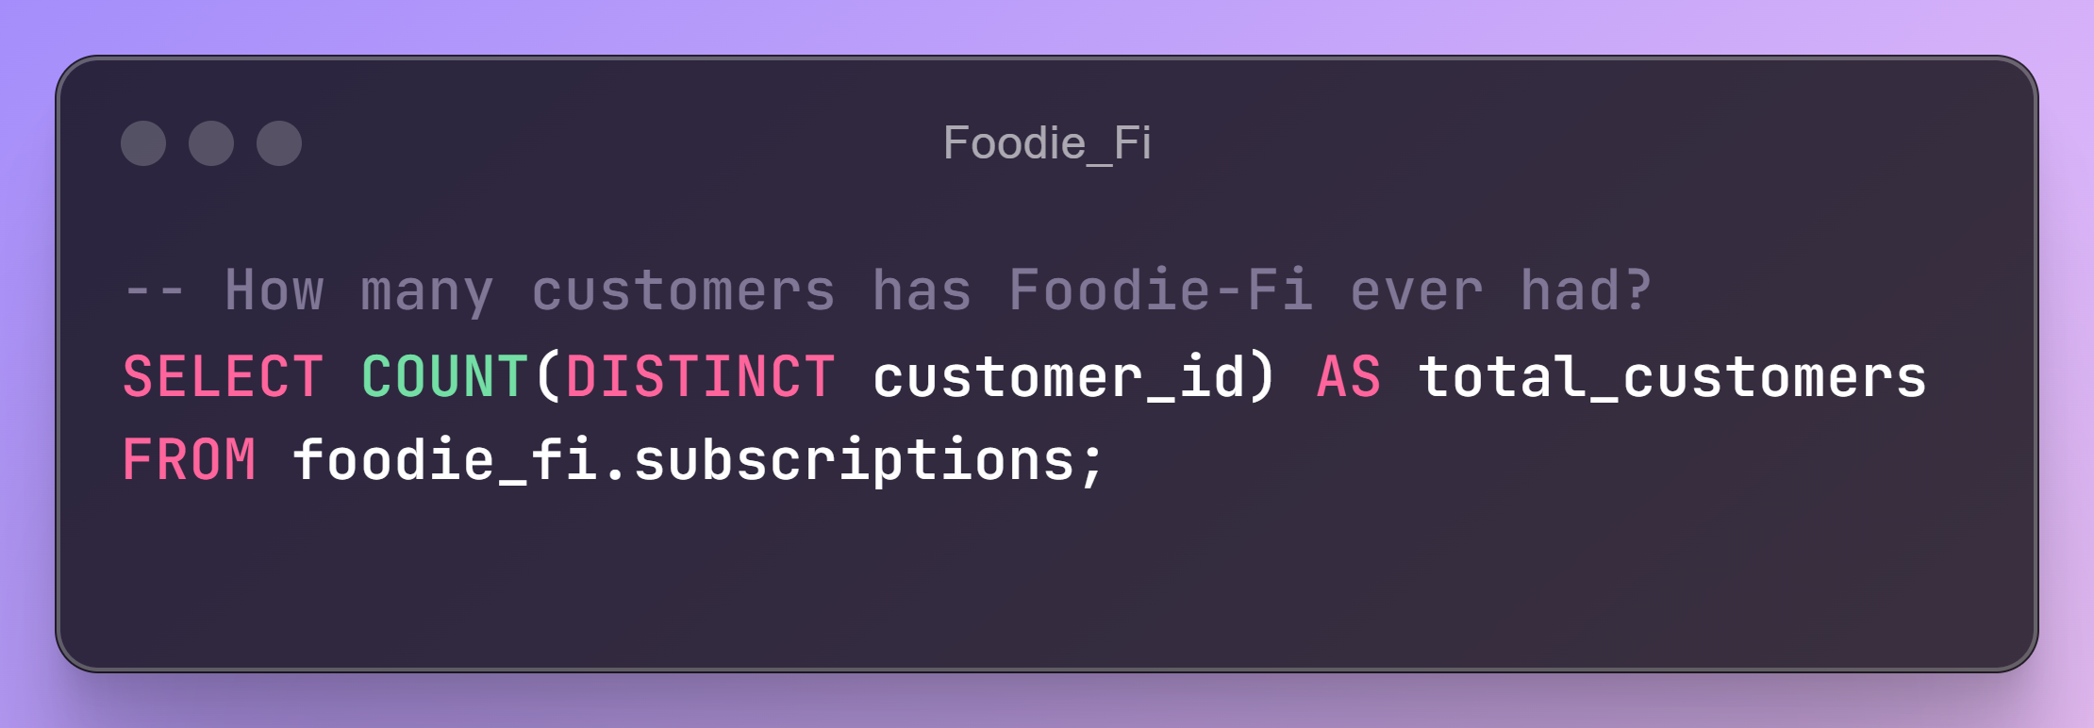
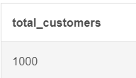

Slide 7
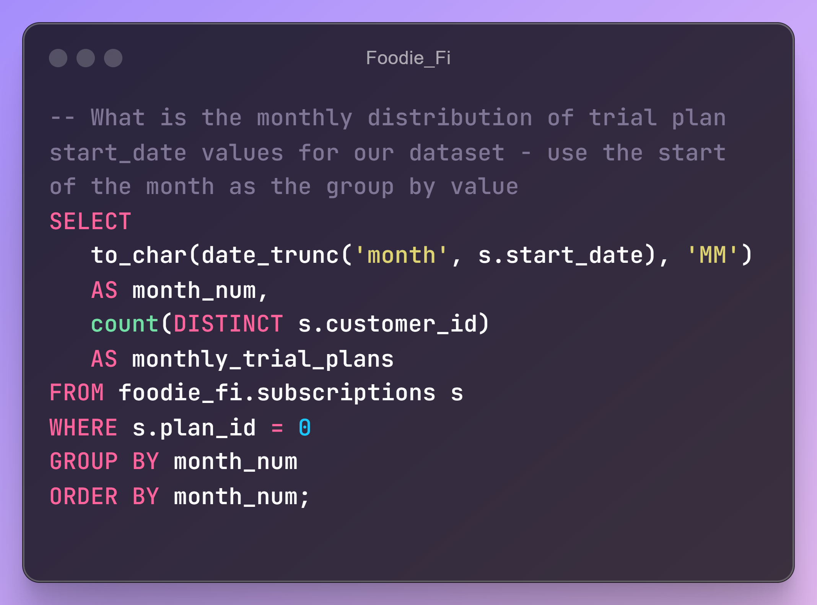
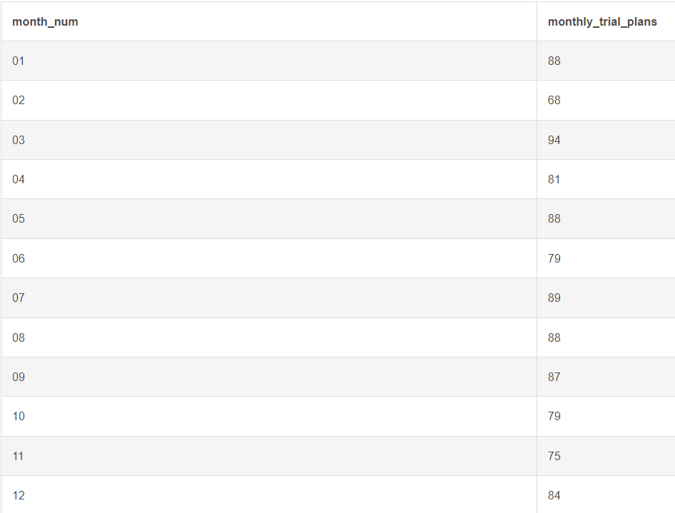

Slide 8
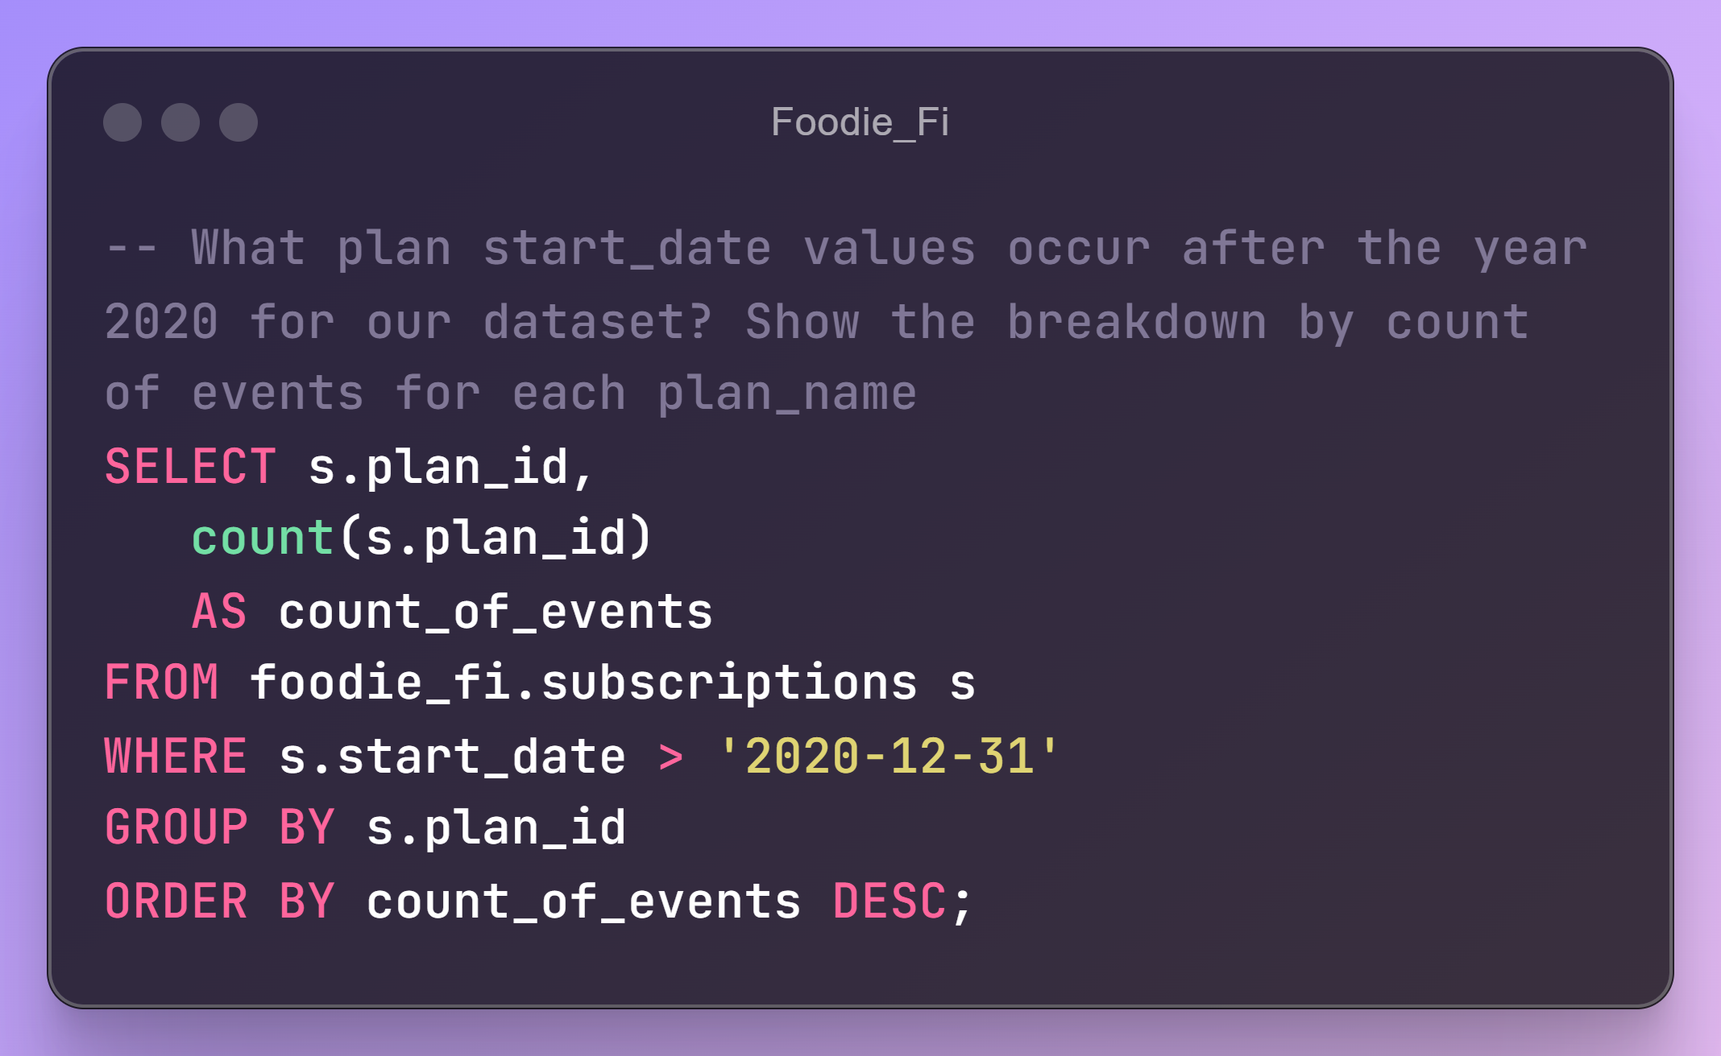
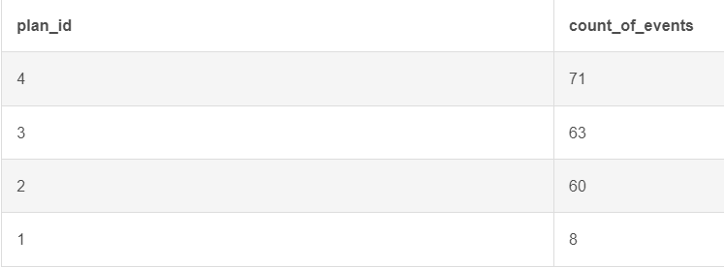

Slide 9
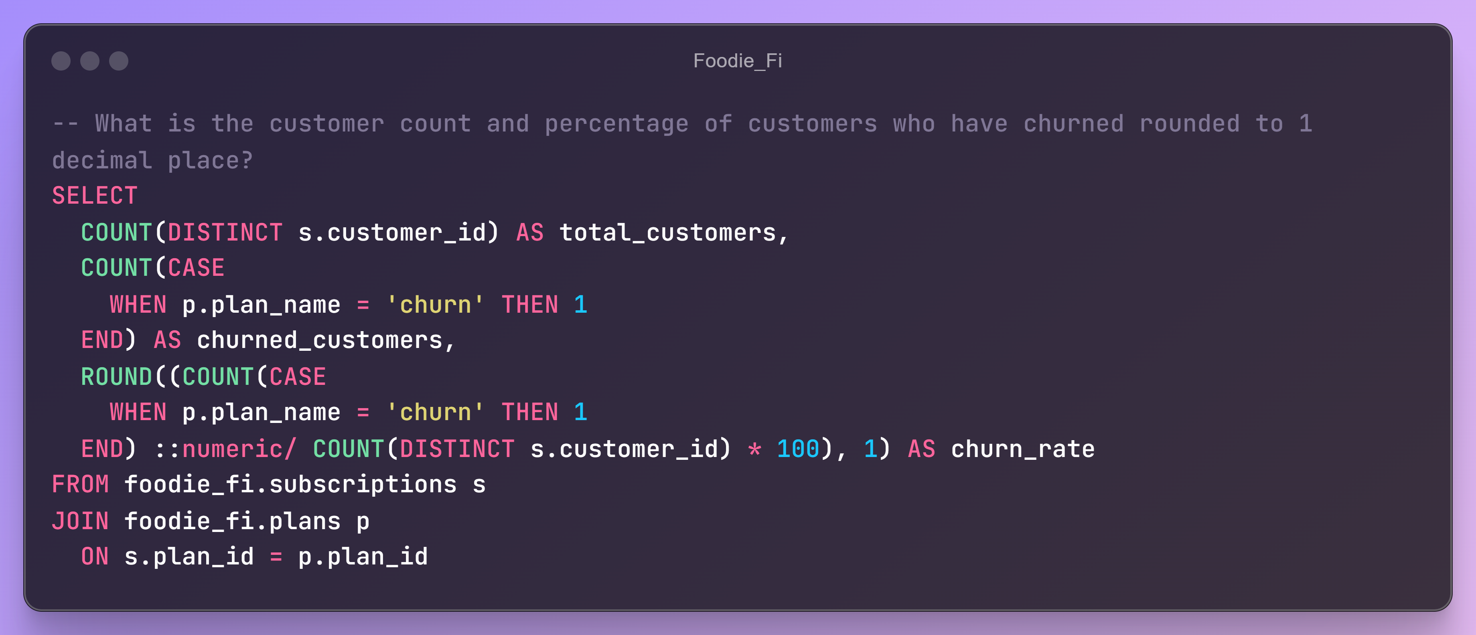

Slide 10
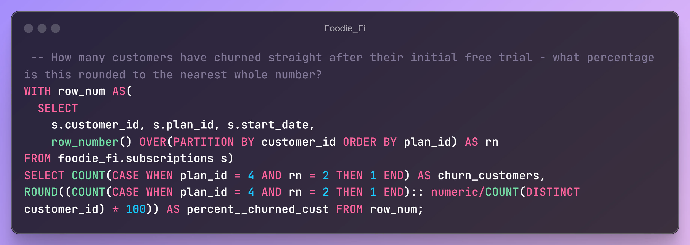
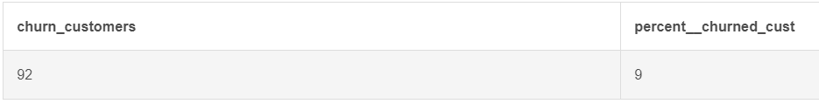

Slide 11
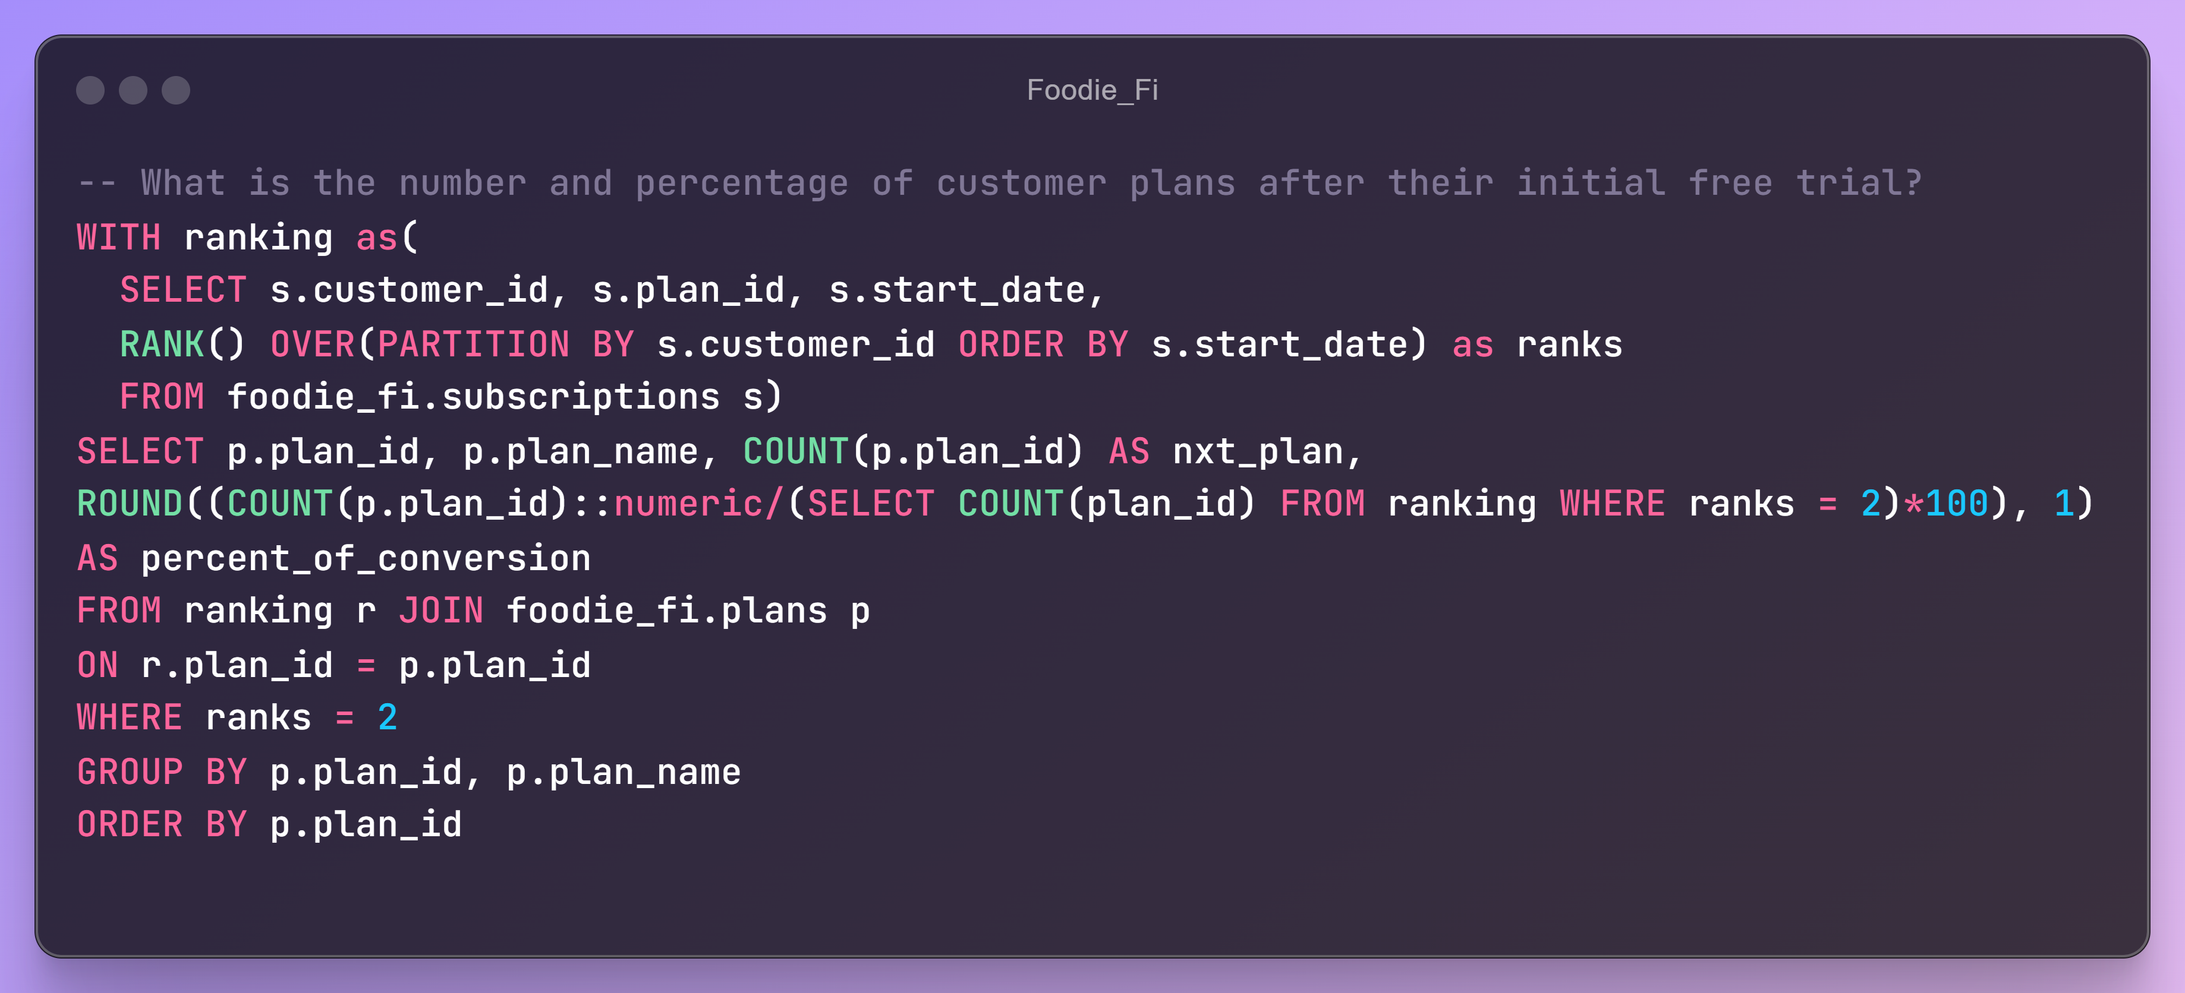
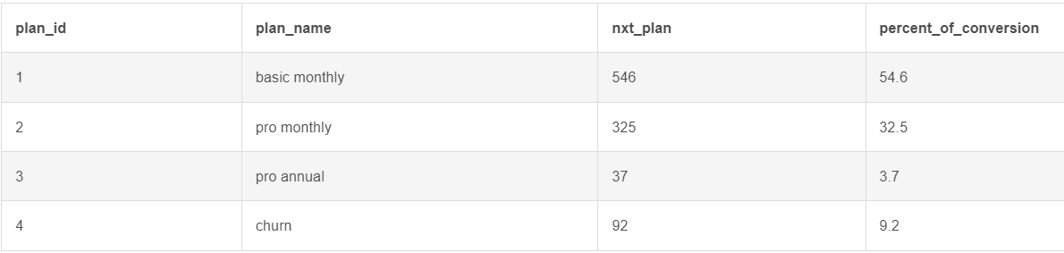

Slide 12
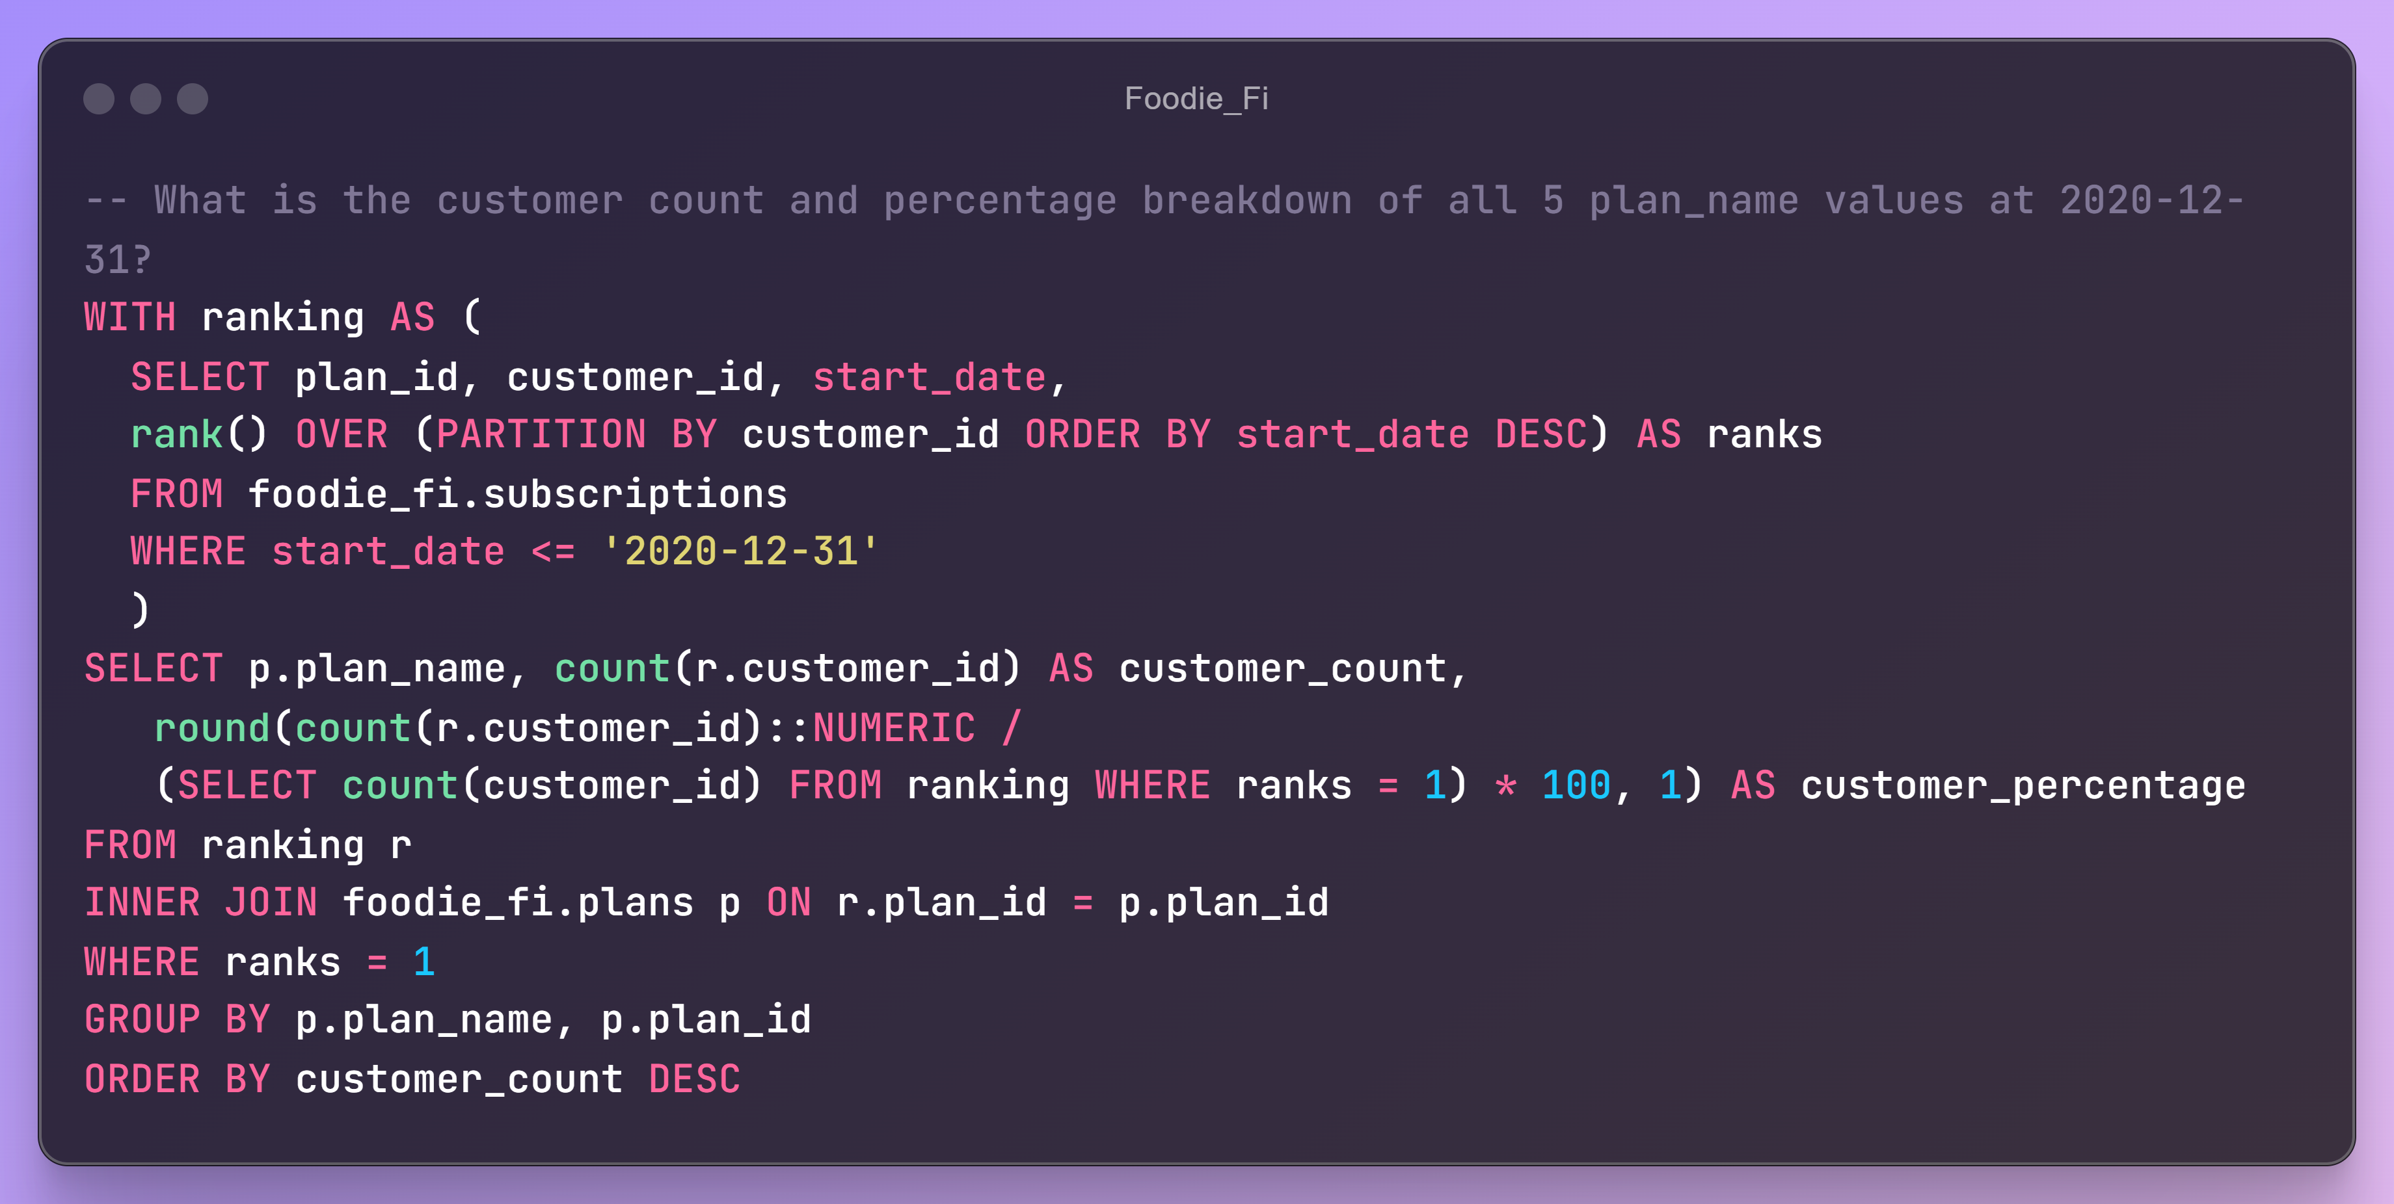
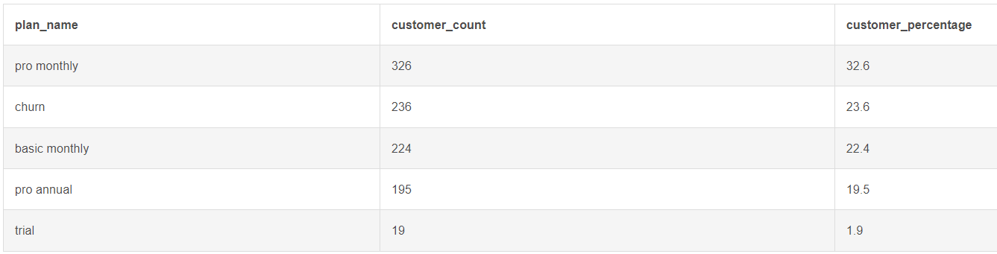

Slide 13
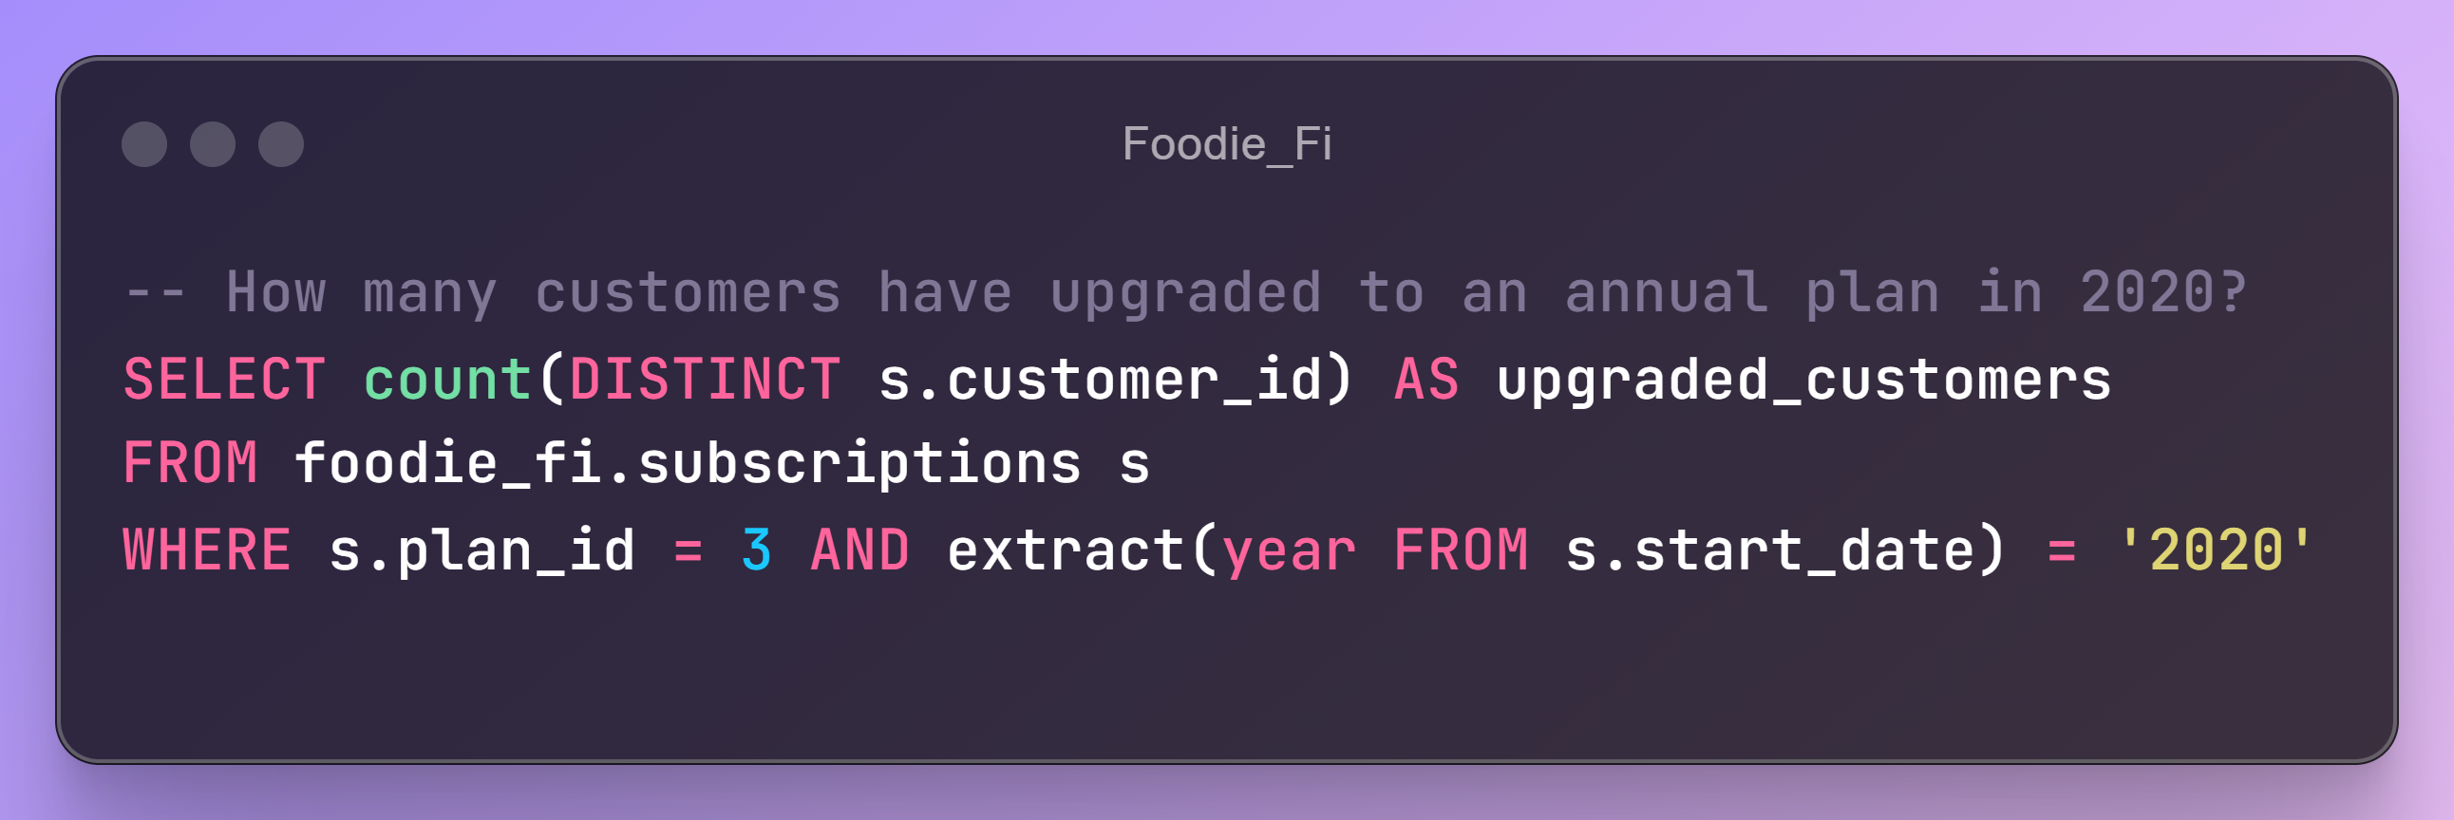
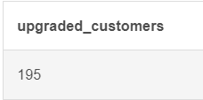

Slide 14
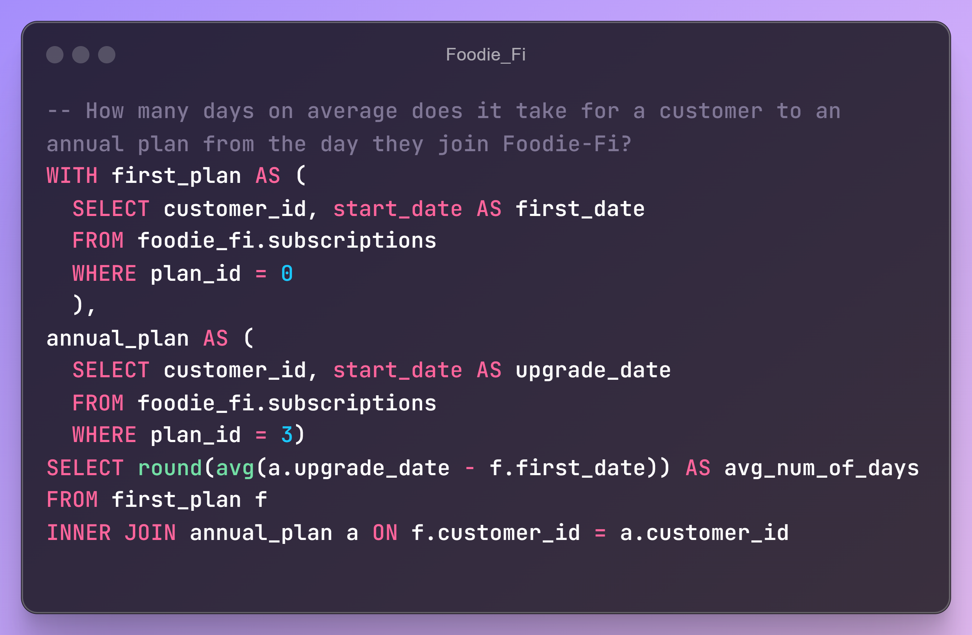
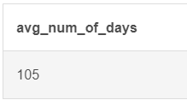

Slide 15
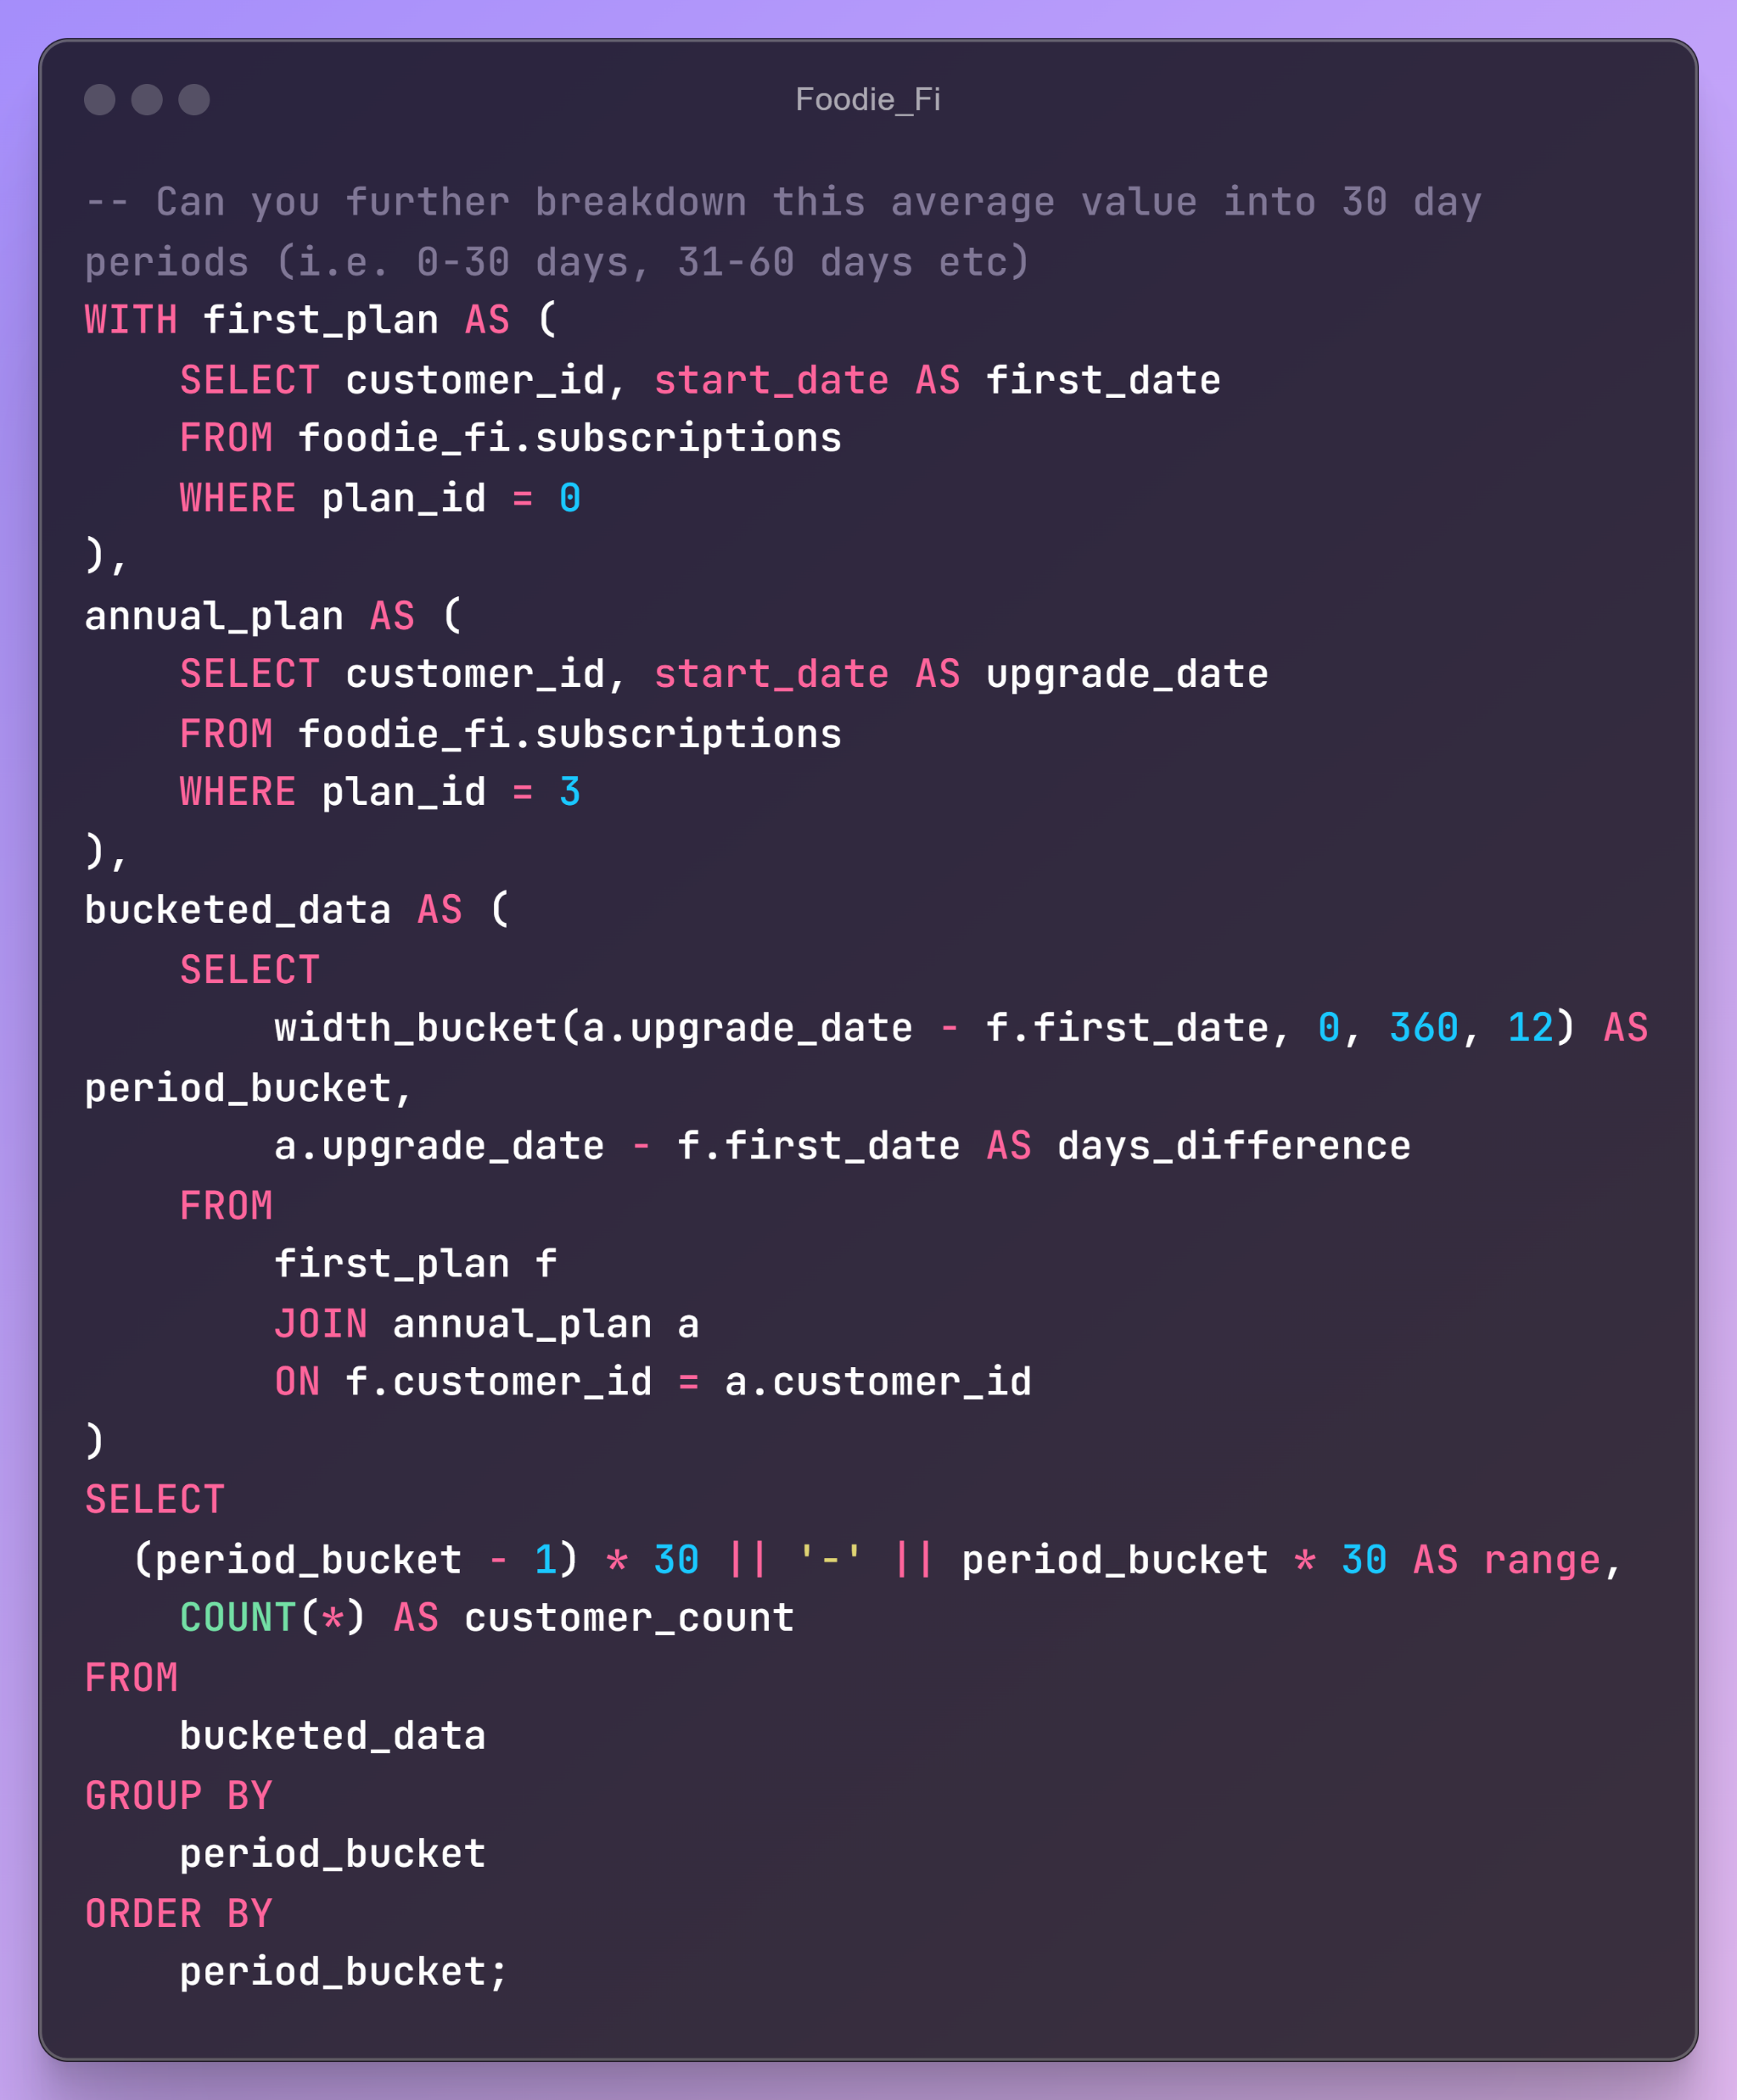
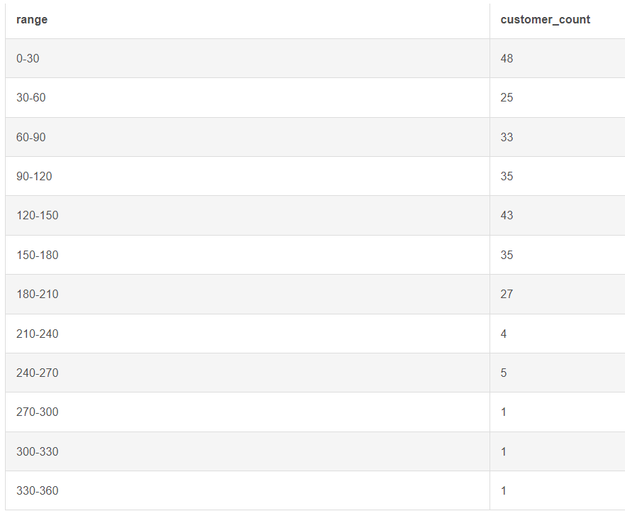

Slide 16
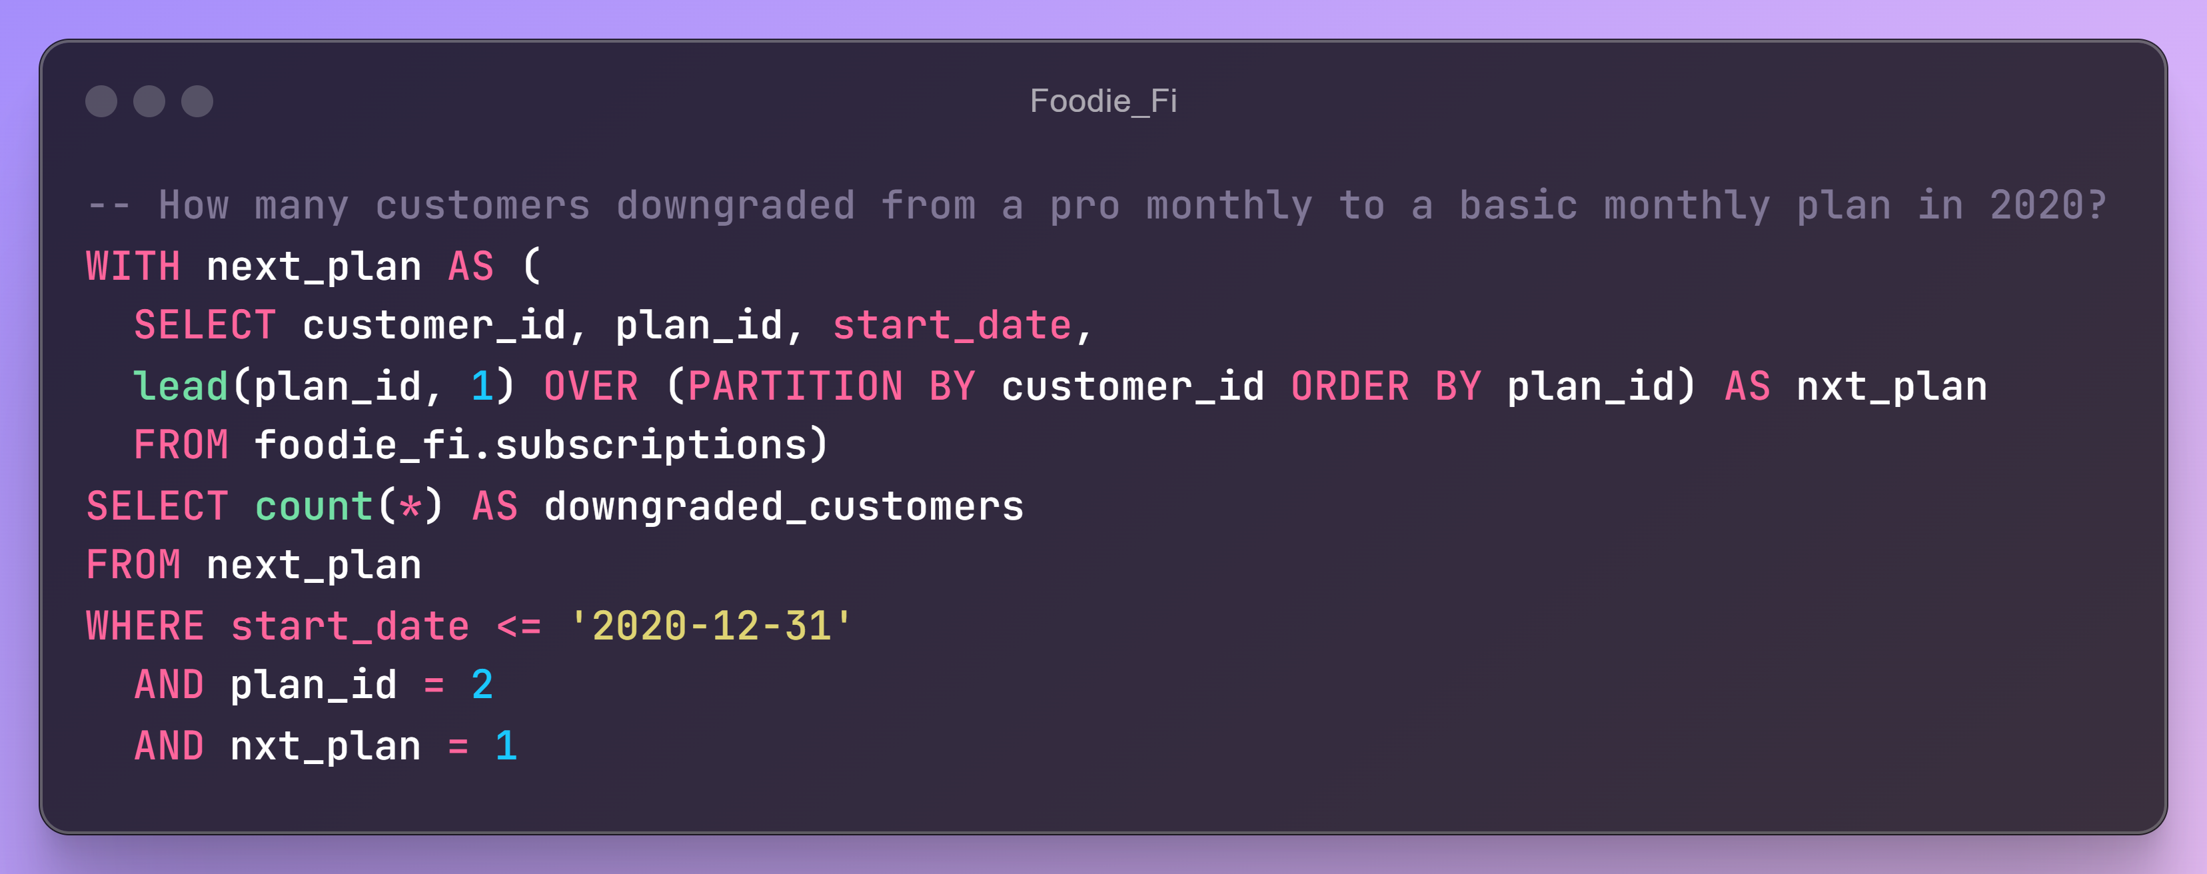
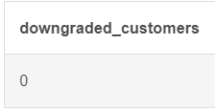

Slide 17
OUTSIDE THE BOX QUESTION:
How would you calculate the rate of growth for Foodie-Fi?
The growth rate depends upon the metric we choose to define growth with. For example:
Revenue Growth: Measure the increase in subscription revenue over a period.
Subscriber Growth: Measure the increase in the number of subscribers over a period.
Further, we can find Simple Growth Rate or Compound Annual Growth Rate based upon whether we want to find short-term trends and insights or the long-term assessment of the business.
What key metrics would you recommend Foodie-Fi management to track over time to assess performance of their overall business?
Metrics such as Subscriber Growth Rate, Churn Rate, Revenue Growth Rate, Average Revenue per User, Conversion Rate, Customer Acquisition Cost, Customer Support Metrics etc.

Slide 18
OUTSIDE THE BOX QUESTION:
What are some key customer journeys or experiences that you would
analyze further to improve customer retention?
Key customer experiences like smooth Onboarding Process, Personalized Suggestions, smooth Upgrading Process, Loyalty Programs, Support Request Journey and Issue Resolution, Acting on Customer Feedback etc.
If the Foodie-Fi team were to create an exit survey shown to customers who wish to cancel their subscription, what questions would you include in the survey?
Question should focus on the Reason for Cancellation, Product Satisfaction and Pricing Perception, Experience with the App and Customer Support, Future Interests etc.

Slide 19
OUTSIDE THE BOX QUESTION:
What business levers could the Foodie-Fi team use to reduce the customer churn rate? How would you validate the effectiveness of your ideas?
Improve Onboarding Process, Enhance Personalization, Optimizing Pricing and Discounts, Strengthen and Ease Customer Support, Flexible Subscriptions, Implement Loyalty Programs etc.

Slide 20
THANK YOU!

